Slide 1
Virtualization techniques
Er. Harneet Kaur
3x-Cloud Certified

Slide 2
Agenda:
Overview
Various terminologies
X86 Virtualization
Notes:
This is another option for an Overview slide.

Slide 3
Virtualization
Virtualization refers to the act of creating a virtual (rather than actual) version of something, including virtual computer hardware platforms, operating systems, storage devices, and computer network resources.
It offers a layer of abstraction between the computing resources and the applications running over it.

Slide 4
Various Terminologies
Virtual Machine: it is a closely detached software device that could run its own operating system and application as if it is running on a physical machine. It contains its own virtual RAM, CPU, Disk, Network etc.
Guest operating system: Operating system running in a VM environment.
Virtual machine monitor: This can be a part of hypervisor or can be a separate software entity, that runs between the host operating system and hypervisor.
Hosted Virtualization: A method where virtualization and partitioning services run on top of a typical OS.

Slide 5
Various Terminologies
Hypervisor: It is a thin layer of software that provides virtual partitioning abilities that run directly on hardware, but underneath higher-level virtualization services.
Types of Hypervisors:
Type 1(bare metal) eg - datacenters
Type 2(hosted) eg-laptop, local

Slide 6
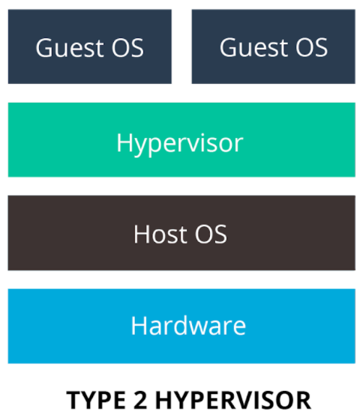
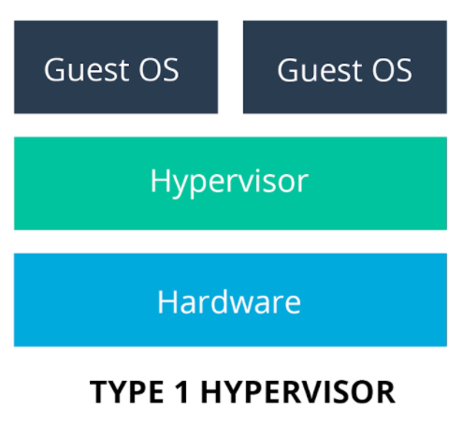

Slide 7
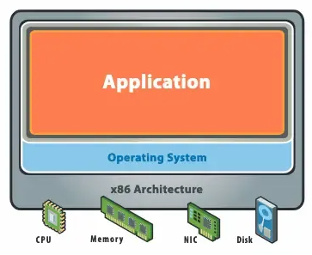
Before Virtualization(x86)
There is one OS image per machine
Software and hardware are tightly bound.
Multiple application that run on the same machine usually creates complexity
Resources are not used optimally
Infrastructure is neither flexible nor economically effective

Slide 8
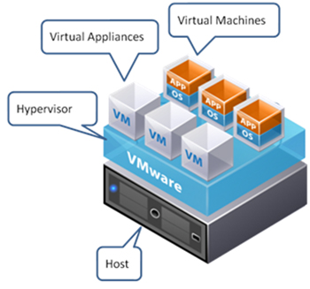
After Virtualization(x86)
Provisioning of VMs can be done on any system
OS and application work as a single unit
OS and applications are independent of hardware

Slide 9
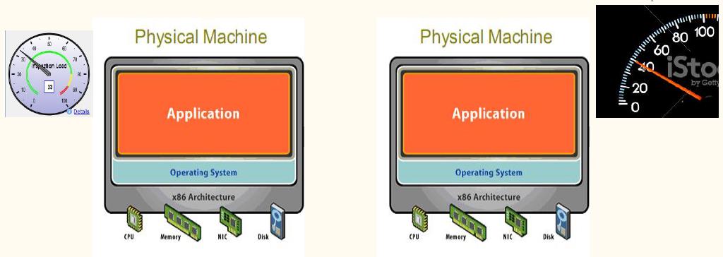
Traditional Scenario-2 server & its utilization

Slide 10
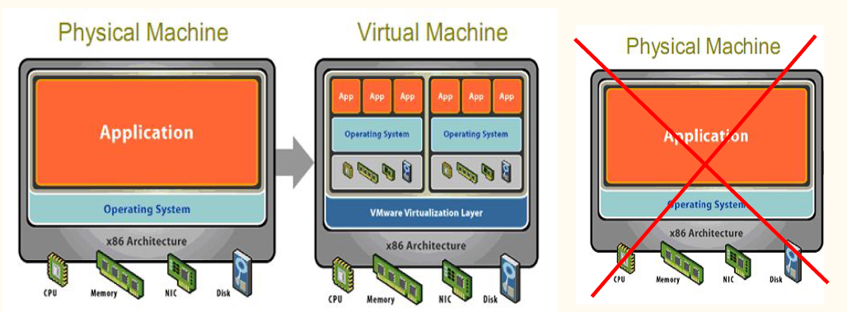
Moving from traditional scenario → virtualized
Notes:
Utilization level=80%

Slide 11
THANK YOU!

